Slide 1
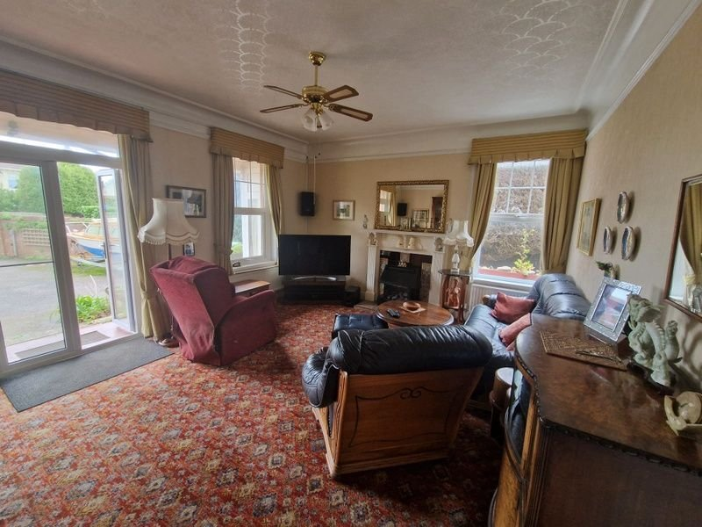
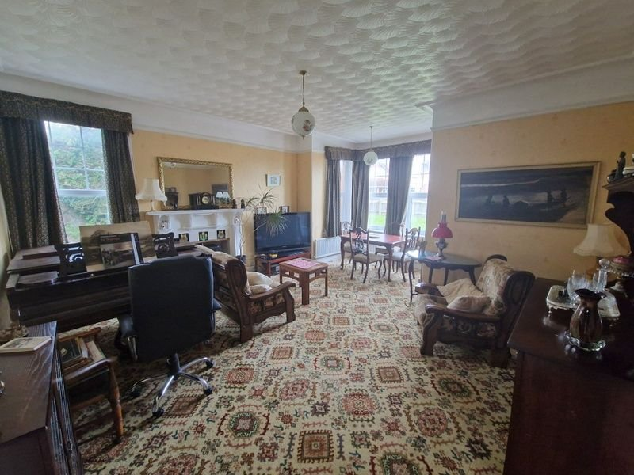
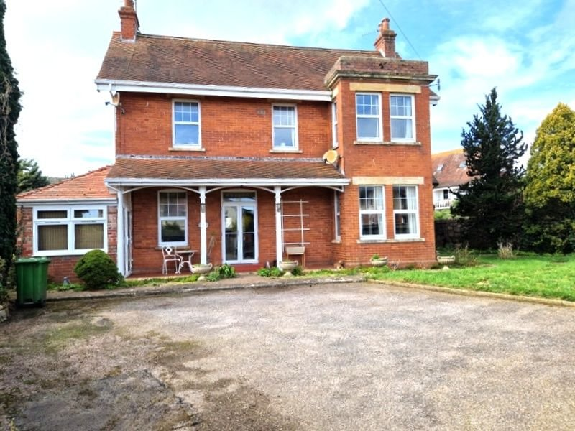
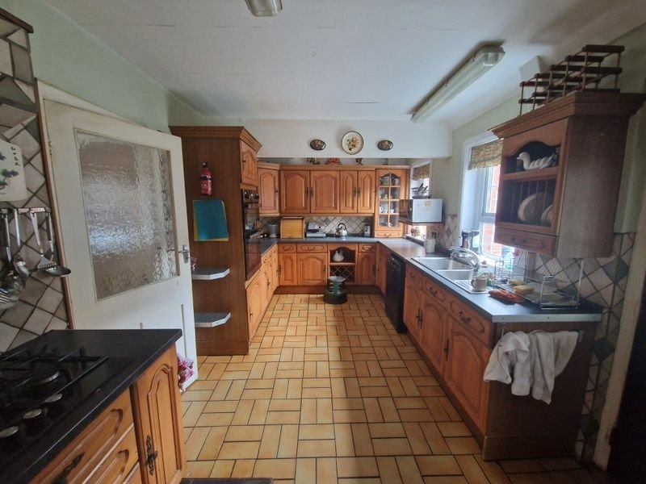
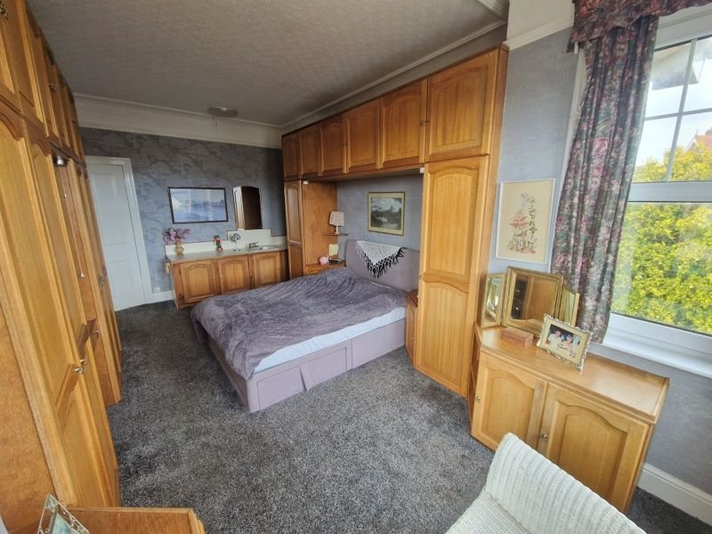
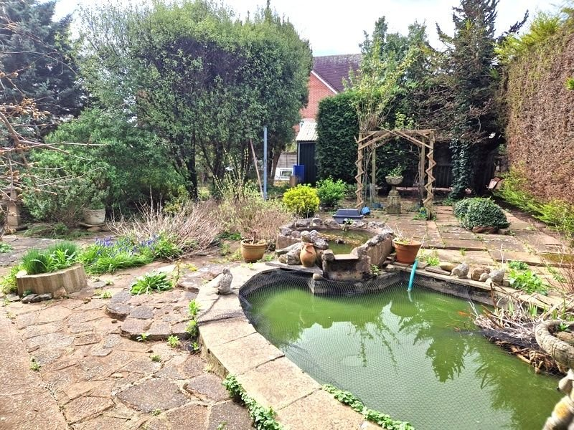
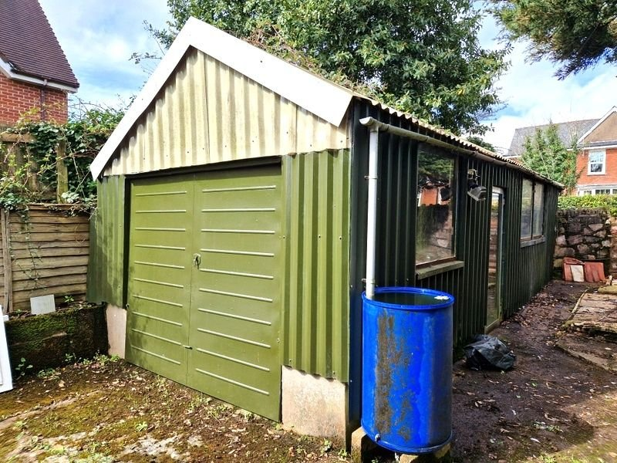
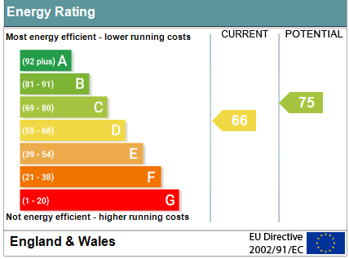
www.pennys.net
2 The Broadway, Exmouth, EX8 2NW
GUIDE PRICE £750,000
TENURE Freehold
An Edwardian Detached House Enjoying A Prominent Corner Position With Good Size Gardens, Ample Parking And Large Workshop/Garage
Entrance Vestibule & Reception Hall • Lounge • Sitting Room •
Breakfast Room • Kitchen •
Cloakroom/WC • Five Bedrooms • Super Shower Room & Separate WC •
Gas Central Heating & Double Glazed Windows • Fine Period Features •
Immense Potential With Development Potential Subject To Consents •
Pennys Estate Agents Limited for themselves and for the vendor of this property whose agents they are give notice that:- (1) These particulars do not constitute any part of an offer or a contract. (2) All statements contained in these particulars are made without responsibility on the part of Pennys Estate Agents Limited. (3) None of the statements contained in these particulars are to be relied upon as a statement or representation of fact. (4) Any intending purchaser must satisfy himself/herself by inspection or otherwise as to the correctness of each of the statements contained in these particulars. (5) The vendor does not make or give and neither do Pennys Estate Agents Limited nor any person in their employment has any authority to make or give any representation or warranty whatever in relation to this property.
PENNYS ESTATE AGENTS
2 Rolle House, Rolle Street, Exmouth, Devon, EX8 2SN
Tel: 01395 264111 EMail: help@pennys.net

Slide 2
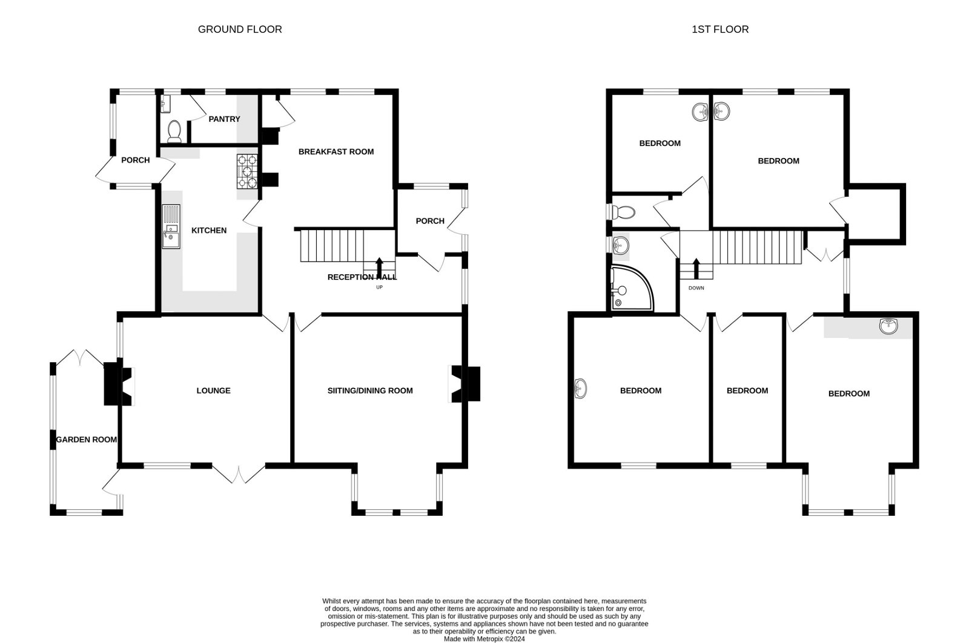
2 The Broadway, Exmouth, EX8 2NW
THE ACCOMMODATION COMPRISES: Leaded light front door to: ENTRANCE VESTIBULE: 2.06m x 1.78m (6'9" x 5'10") Tiled floor; leaded light windows; inner solid wood floor with leaded light window inset to: RECEPTION HALL: With staircase rising to the first floor with original newel post; radiator; understairs cupboard; picture rail. LOUNGE: 5.79m x 4.88m (19'0" x 16'0") into uPVC double glazed square bay window. A dual aspect room with further uPVC double glazed window; feature fireplace with tiled chimney recess; radiator; television point; picture rail. SITTING ROOM: 4.88m x 4.27m (16'0" x 14'0") A dual aspect reception room with uPVC double glazed windows to two aspects and double glazed patio doors opening COVERED VERANDAH; two radiators; dado and picture rails; fireplace housing gas coal effect fire. BREAKFAST ROOM: 3.96m x 3.63m (13'0" x 11'11") Chimney recess with stone recess; cupboard housing Valliant boiler; fitted dresser unit; uPVC double glazed windows; cupboard housing electric meter. KITCHEN: 4.83m x 2.84m (15'10" x 9'4") Fitted with a range of pattern worktop surfaces with inset double bowl sink unit with cupboards, drawer units and dishwasher space beneath; four ring gas hob with extractor hood over and cupboards, drawer units beneath; eye-level cupboards; built-in oven; plate rack; tiled surrounds; two uPVC double glazed windows; part glazed door to: PANTRY: 1.96m x 1.52m (6'5" x 5'0") Space for white goods; tiled floor; wall mounted cupboards; uPVC double glazed window; door to: CLOAKROOM/WC: WC with push button flush; space saver wash hand basin; two uPVC double glazed windows; tiled floor. FROM KITCHEN DOOR TO:
REAR UTILITIES PORCH: 3.05m x 1.22m (10'0" x 4'0") Three uPVC double glazed windows and uPVC double glazed door to outside; wall mounted cupboards; plumbing for an automatic washing machine. FIRST FLOOR GALLERIED LANDING: uPVC double glazed leaded light window; fitted cupboard; picture rail; access to loft space via loft ladder which is partly boarded with power and light connected (this space is prime for conversion for additional rooms subject to consents).
BEDROOM ONE: 5.79m x 3.4m (19'0" x 11'2") into uPVC double glazed square bay window; tilt & turn windows; built-in bed furniture including matching wardrobes, bedside tables, cupboards, drawer units and dressing table with mirror over; wash hand basin set in tiled display surface with mirror; picture rail; radiator. BEDROOM TWO: 4.24m x 3.81m (13'11" x 12'6") Dual aspect bedroom and uPVC double glazed window; radiator; wash hand basin; picture rail. BEDROOM THREE: 3.94m x 3.66m (12'11" x 12'0") Two uPVC double glazed windows; wash hand basin with light and medicine cabinet over; chimney recess; access to roof void/cupboard with light. BEDROOM FOUR: 2.82m x 2.82m (9'3" x 9'3") uPVC double glazed tilt & turn window; wash hand basin with tiled display surface, light and mirror over; picture rail. BEDROOM FIVE: 4.24m x 2.49m (13'11" x 8'2") uPVC double glazed window; wash hand basin set in display surface with cupboards over and tiled splash back, mirror and light; picture rail; radiator.
SHOWER ROOM: 2.59m x 2.03m (8'6" x 6'8") Fitted with a two seater shower cubicle with wall jets and over head shower, speakers; curved screen doors; slatted wood floor; splash back walls; vanity wash hand basin; chrome heated towel rail; electric wall heater; uPVC double glazed window with pattern glass. SEPARATE WC: WC; wash hand basin. OUTSIDE: The property is approached via sliding electrically operated iron gates to a good size driveway/parking area with lawned front gardens with pedestrian gate and pathway to front door. The rear garden is enclosed via brick walls comprising of large patio areas, fish pond, mature shrubs and conifers, SUBSTANTIAL WORK SHOP/GARAGE, brick garden store with pathway back around to the front of the property. From the garden access via uPVC double glazed doors to: GARDEN ROOM: 4.37m x 1.88m (14'4" x 6'2") uPVC double glazed windows and uPVC double glazed door to front driveway, outside tap and lighting. DRIVE THROUGH WORKSHOP/GARAGE: 9.14m x 2.92m (30'0" x 9'7") Up and over door with vehicle access via Salterton Road. Up and over door through to garden, power and light connected.
FLOOR PLAN:

